Slide 1
IP Addresses:
Classless Addressing
Objectives
Upon completion you will be able to:
Understand the concept of classless addressing
Be able to find the first and last address given an IP address
Be able to find the network address given a classless IP address
Be able to create subnets from a block of classless IP addresses
Understand address allocation and address aggregation

Slide 2
5.1 VARIABLE-LENGTH BLOCKS
In classless addressing variable-length blocks are assigned that belong to no class. In this architecture, the entire address space (2³² addresses) is divided into blocks of different sizes.

Slide 3
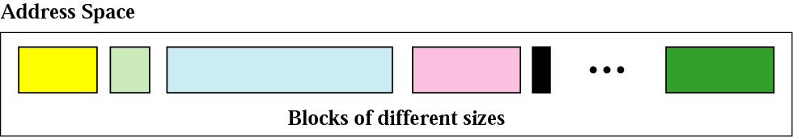
Variable-length blocks

Slide 4
Number of Addresses
Number of Addresses in a Block
There is only one condition on the number of addresses in a block; it must be a power of 2 (2, 4, 8, . . .).
A household may be given a block of 2 addresses.
A small business may be given 16 addresses.
A large organization may be given 1024 addresses.

Slide 5
Beginning Address
Beginning Address
The beginning address must be evenly divisible by the number of addresses.
For example, if a block contains 4 addresses, the beginning address must be divisible by 4.

Slide 6
Example 1
Which of the following can be the beginning address of a block that contains 16 addresses?
a. 205.16.37.32 b.190.16.42.44
c. 17.17.33.80 d.123.45.24.52
Solution
Only two are eligible (a and c). The address 205.16.37.32 is eligible because 32 is divisible by 16. The address 17.17.33.80 is eligible because 80 is divisible by 16.

Slide 7

Format of classless addressing address
Prefix ->name for the common part of the address range(similar to netid)
  Prefix length->length of the prefix /n
Suffix->varying part(similar to hostid)
  Suffix length->length of the suffix (32-n) in CIDR notation

Slide 8
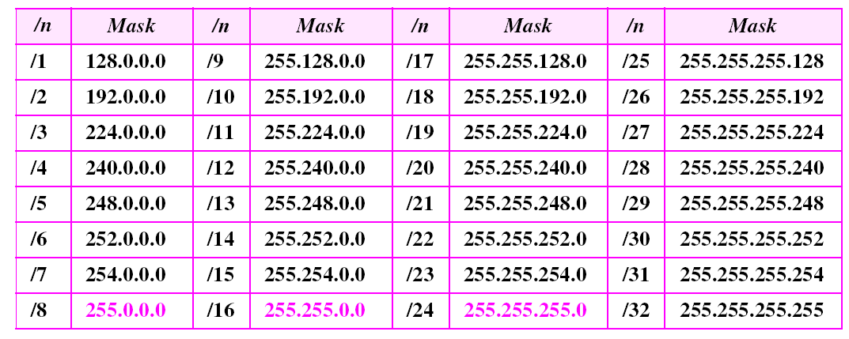
Prefix lengths

Slide 9
Problem Finding the Block
Finding the block given the classless address
  Finding the first address.
  Finding number of addresses
  Finding the last address

Slide 10
Network Addresses
In IPv4 addressing, a block of addresses can be defined as x.y.z.t /n, in which x.y.z.t defines one of the addresses and the /n defines the mask.
The first address in the block can be found by setting the rightmost 32 − n bits to 0s.
The last address in the block can be found by setting the rightmost 32 − n bits to 1s.

Slide 11
Example 3
A block of addresses is granted to a small organization. We know that one of the addresses is 205.16.37.39/28. What is the first address in the block?
Solution
The binary representation of the given address is
11001101 00010000 00100101 00100111
If we set 32−28 rightmost bits to 0, we get
11001101 00010000 00100101 00100000
or
205.16.37.32.
This is actually the block shown in Figure

Slide 12
Example 4
A block of addresses is granted to a small organization.
We know that one of the addresses is 205.16.37.39/28.
What is the last address in the block?
Solution
The binary representation of the given address is
11001101 00010000 00100101 00100111
If we set 32 − 28 rightmost bits to 1, we get
11001101 00010000 00100101 00101111
or
205.16.37.47
This is actually the block shown in Figure.

Slide 13
The number of addresses in the block can be found by using the formula 2^{32-N}.
Example 5
A block of addresses is granted to a small organization. We know that one of the addresses is 205.16.37.39/28.Find the total number of address in the block.
Solution
The value of n is 28, which means that number
of addresses is 2 ³²⁻²⁸ or 16.

Slide 14
Example 6
Another way to find the first address, the last address, and the number of addresses is to represent the mask as a 32-bit binary (or 8-digit hexadecimal) number. This is particularly useful when we are writing a program to find these pieces of information. In Example 3 the /28 can be represented as
11111111 11111111 11111111 11110000
(twenty-eight 1s and four 0s).
Find
a. The first address
b. The last address
c. The number of addresses.

Slide 15

Example 6 (continued)
Solution
a. The first address can be found by ANDing the given
addresses with the mask. ANDing here is done bit by
bit. The result of ANDing 2 bits is 1 if both bits are 1s;
the result is 0 otherwise.

Slide 16

Example 6 (continued)
b. The last address can be found by ORing the given
addresses with the complement of the mask. ORing
here is done bit by bit. The result of ORing 2 bits is 0 if
both bits are 0s; the result is 1 otherwise. The
complement of a number is found by changing each 1
to 0 and each 0 to 1.

Slide 17
Example 6 (continued)
c. The number of addresses can be found by
complementing the mask, interpreting it as a decimal
number, and adding 1 to it.

Slide 18
Finding the first address-First Short cut method
Divide the prefix length into four groups and find the number of 1s in each group.
If the number of 1s in a group is 8,the corresponding byte in the first address is the same(no change).
If the number of 1s in a group is zero(no 1s),the corresponding byte in the first adress is 0.
If the number of 1s in a group is between zero and eight, we keep the corresponding bits in that group.

Slide 19
Finding the first address-First Short cut method example
What is the first address in the block if one of the addresses is 140.120.84.24/20?
ip address
140 . 120. 84. 24
/n 8 . 8 . 4 . 0
First address
140. 120. 80. 0 ->first address
84->01010100
/n-> 11110000
Keep the left 4 bits 01010000
Result in decimal-> 80

Slide 20
Example 4
What is the first address in the block if one of the addresses is 167.199.170.82/27?
Solution
The prefix length is 27, which means that we must keep the first 27 bits as it is and change the remaining bits (5) to 0s. The following shows the process:
Address in binary: 10100111 11000111 10101010 01010010
Keep the left 27 bits: 10100111 11000111 10101010 01000000
Result in CIDR notation: 167.199.170.64/27

Slide 21
Example 5
What is the first address in the block if one of the addresses is 140.120.84.24/20?
Solution
The first, second, and fourth bytes are easy; for the third byte we keep the bits corresponding to the number of 1s in that group. The first address is 140.120.80.0/20.
See Next Slide

Slide 22
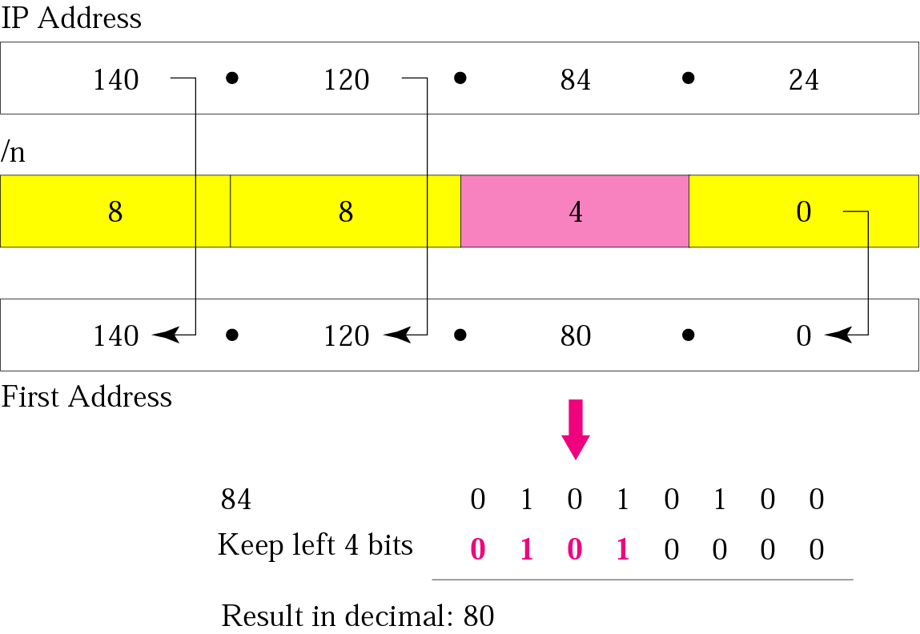
Example 5 - Solution

Slide 23
Example 7
Find the number of addresses in the block if one of the addresses is 140.120.84.24/20.
Solution
The prefix length is 20. The number of addresses in the block is 2³²⁻²⁰ or 2¹² or 4096. Note that
this is a large block with 4096 addresses.

Slide 24
Example 10
Find the block if one of the addresses is 190.87.140.202/29.
Solution
We follow the procedure in the previous examples to find the first address, the number of addresses, and the last address. To find the first address, we notice that the mask (/29) has five 1s in the last byte.
See Next Slide

Slide 25
Example 10 (Continued)
The number of addresses is 2³²⁻²⁹ or 8. In other words, the first address is 190.87.140.200/29, the last address is 190.87.140.207/29. There are only 8 addresses in this block.

Slide 26

Note:
In classless addressing, the first address is used as network address and the last address is kept as a special address(limited broadcast address)

Slide 27
Note:
In classless addressing, the last address in the block does not necessarily end in 255.

Slide 28
Note:
In CIDR notation, the block granted is defined by the first address and the prefix length.

Slide 29
SUBNETTING
When an organization is granted a block of addresses, it can create subnets to meet its needs.
The prefix length increases to define the subnet prefix length.

Slide 30

Configuration and addresses in a subnetted network

Slide 31

Three-level hierarchy in an IPv4 address

Slide 32
Fixed length subnetting Example
What are the subnet addresses and the range of addresses for each subnet if the address of the block is 130.34.12.64/26? There are four number of subnets are available, each with same number of addresses.
Solution
Figure shows one configuration.
See Next Slide

Slide 33
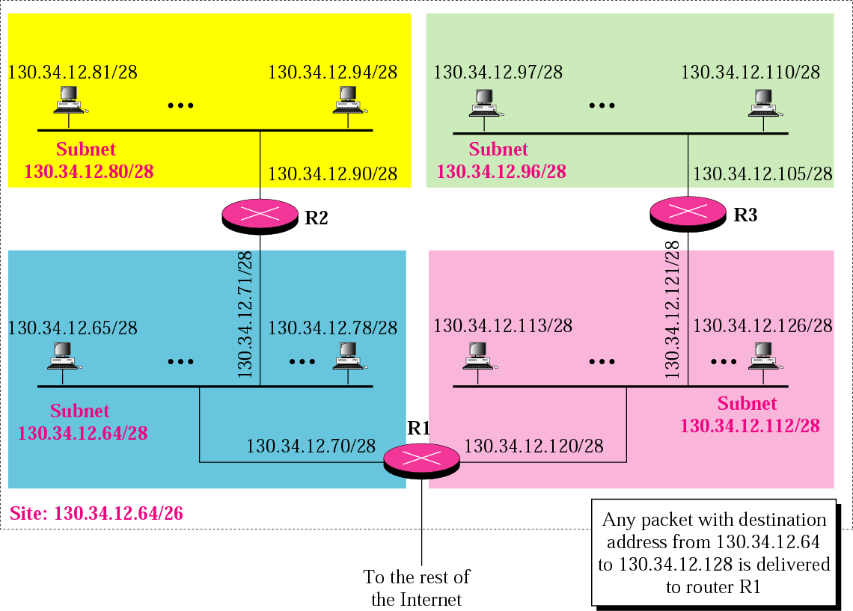
Example 13

Slide 34
Example 13 (Continued)
The site has 2³²⁻²⁶ = 64 addresses. Each subnet has 2^{32–28} = 16 addresses. Now let us find the first and last address in each subnet.
1. The first address in the first subnet is 130.34.12.64/28, using the procedure we showed in the previous examples. Note that the first address of the first subnet is the first address of the block. The last address of the subnet can be found by adding 15 (16 −1) to the first address. The last address is 130.34.12.79/28.
See Next Slide

Slide 35
Example 13 (Continued)
2.The first address in the second subnet is 130.34.12.80/28; it is found by adding 1 to the last address of the previous subnet. Again adding 15 to the first address, we obtain the last address, 130.34.12.95/28.
3. Similarly, we find the first address of the third subnet to be 130.34.12.96/28 and the last to be 130.34.12.111/28.
4. Similarly, we find the first address of the fourth subnet to be 130.34.12.112/28 and the last to be 130.34.12.127/28.

Slide 36
Variable length subnetting
An organization is granted a block of addresses with the beginning address 14.24.74.0/24. There are 2³²⁻²⁴= 256 addresses in this block. The organization needs to have 11 subnets as shown below:
a. two subnets, each with 64 addresses.
b. two subnets, each with 32 addresses.
c. three subnets, each with 16 addresses.
d. four subnets, each with 4 addresses.
Design the subnets.
See Next Slide For One Solution

Slide 37
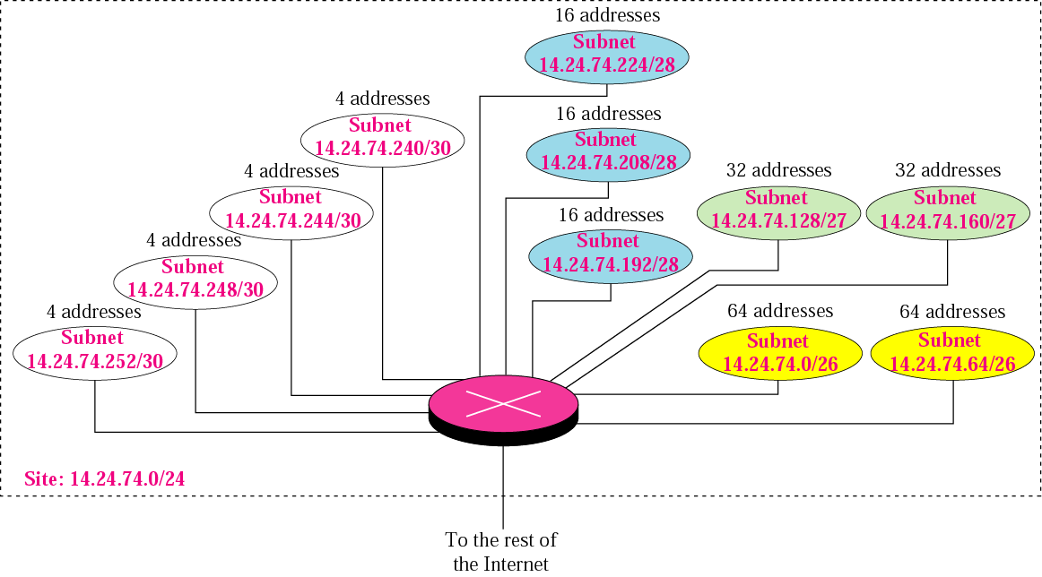
Example 14

Slide 38
Example 15
As another example, assume a company has three offices: Central, East, and West. The Central office is connected to the East and West offices via private, point-to-point WAN lines. The company is granted a block of 64 addresses with the beginning address 70.12.100.128/26. The management has decided to allocate 32 addresses for the Central office and divides the rest of addresses between the two offices. Figure 5.8 shows the configuration designed by the management.
See Next Slide

Slide 39
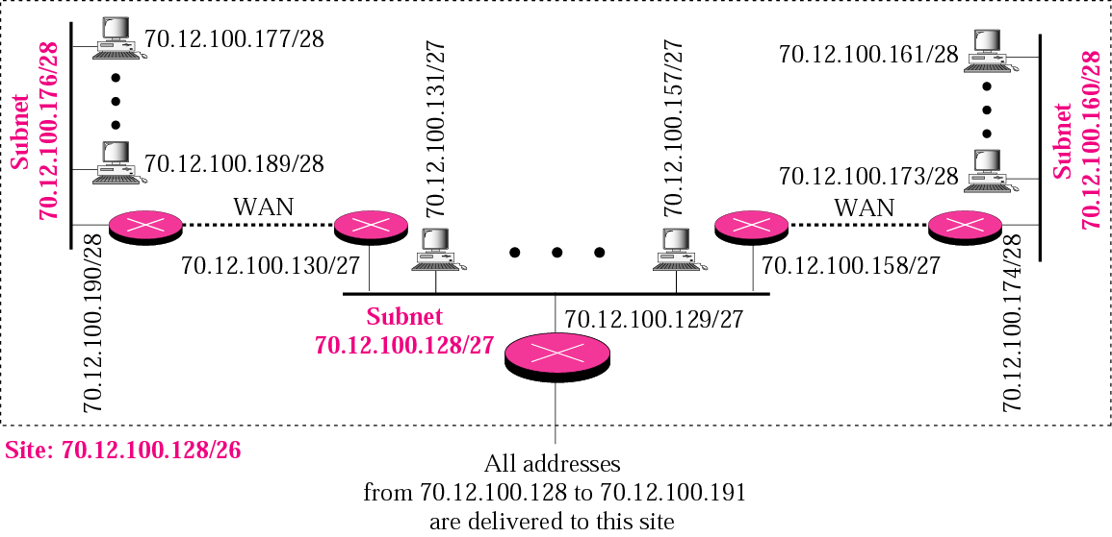
Example 15

Slide 40
ADDRESS ALLOCATION
Address allocation is the responsibility of a global authority called the Internet Corporation for Assigned Names and Addresses (ICANN). It usually assigns a large block of addresses to an ISP to be distributed to its Internet users.
Address aggregation: Many blocks of addresses are aggregated in one block and granted to one ISP

Slide 41
Example 16
An ISP is granted a block of addresses starting with 190.100.0.0/16 (65,536 addresses). The ISP needs to distribute these addresses to three groups of customers as follows:
The first group has 64 customers; each needs 256 addresses.
b. The second group has 128 customers; each needs 128 addresses
c. The third group has 128 customers; each needs 64 addresses.
Design the subblocks and find out how many addresses are still available after these allocations.
See Next Slide

Slide 42
Example 16 (Continued)
Design the subblocks and find out how many addresses are still available after these allocations.
Solution
Figure 5.9 shows the situation.
See Next Slide

Slide 43
Example 16 (Continued)
Group 1
For this group, each customer needs 256 addresses. This means the suffix length is 8 (2⁸ =256). The prefix length is then 32 − 8 = 24. The addresses are:
1st Customer 190.100.0.0/24 190.100.0.255/24
2nd Customer 190.100.1.0/24 190.100.1.255/24
. . .
64th Customer 190.100.63.0/24 190.100.63.255/24
Total = 64 × 256 = 16,384
See Next Slide

Slide 44
Example 16 (Continued)
Group 2
For this group, each customer needs 128 addresses. This means the suffix length is 7 (2⁷ =128). The prefix length is then 32 − 7 = 25. The addresses are:
1st Customer 190.100.64.0/25 190.100.64.127/25
2nd Customer 190.100.64.128/25 190.100.64.255/25
· · ·
128th Customer 190.100.127.128/25 190.100.127.255/25
Total = 128 × 128 = 16,384
See Next Slide

Slide 45
Example 16 (continued)
Group 3
For this group, each customer needs 64 addresses. This means the suffix length is 6 (26 = 64). The prefix length is then 32 − 6 = 26. The addresses are:
1st Customer 190.100.128.0/26 190.100.128.63/26
2nd Customer 190.100.128.64/26 190.100.128.127/26
· · ·
128th Customer 190.100.159.192/26 190.100.159.255/26
Total = 128 × 64 = 8,192
See Next Slide

Slide 46
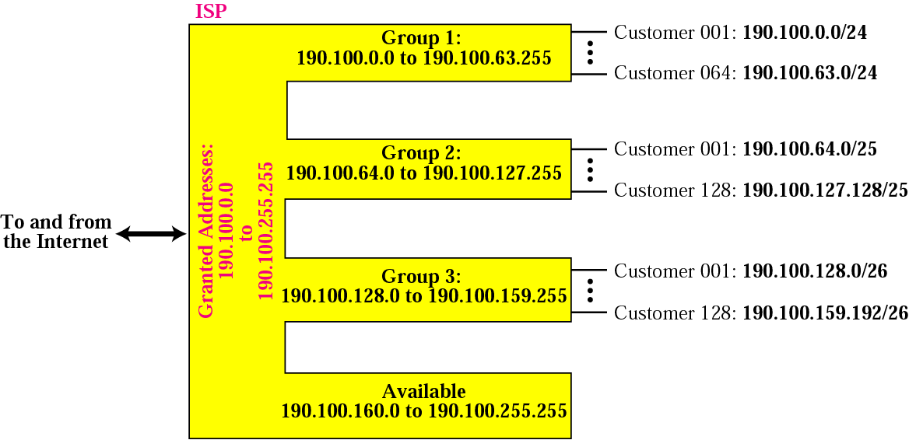
Example 16 (continued)
Number of granted addresses to the ISP: 65,536
Number of allocated addresses by the ISP: 40,960
Number of available addresses: 24,576

Slide 47
Example
An ISP is granted a block of addresses starting with 50.80.0.0/16.
The ISP needs to distribute these blocks to 1000 customers as
follows:
-The first group has 200 medium-sized businesses; each needs
128 addresses.
-The second group has 400 small businesses; each needs 16
addresses.
-The third group has 2000 households; each needs 4
addresses.
Design the subblocks and give the slash notation for each subblock.Find out how many addresses are still available after these allocations.

Slide 48

Addresses for private networks

Slide 49

NAT address translation

Slide 50
IPv6 ADDRESSES
Despite all short-term solutions, address depletion is still a long-term problem for the Internet. This and other problems in the IP protocol itself have been the motivation for IPv6.

Slide 51

Note
An IPv6 address is 128 bits long.
19.<number>

Slide 52

IPv6 address in binary and hexadecimal colon notation
19.<number>

Slide 53

Abbreviated IPv6 addresses
19.<number>

Slide 54

Example 19.11
Expand the address 0:15::1:12:1213 to its original.
Solution
We first need to align the left side of the double colon to the left of the original pattern and the right side of the double colon to the right of the original pattern to find how many 0s we need to replace the double colon.
This means that the original address is.
19.<number>

